Slide 1

Travel Agency management software

Slide 2
Introduction
So... we got to the end part
In this presentation we, Team 2, are going to introduce you to the best
aviation package system on the market!
Today, we will present our system at all levels - from the planning process, the construction process to the polishing processes that led us to produce a quality, reliable and easy-to-use system.
The entire system was built with one vision that stemmed from the transition from manual labor to computer work - the convenience of the customer and users is above all.
As part of the presentation of the system, we will talk about the difficulties and challenges that accompanied us as a team that was established in one night, how we overcame them and managed to create a system that is tailored to our customers' measurements.

Slide 3
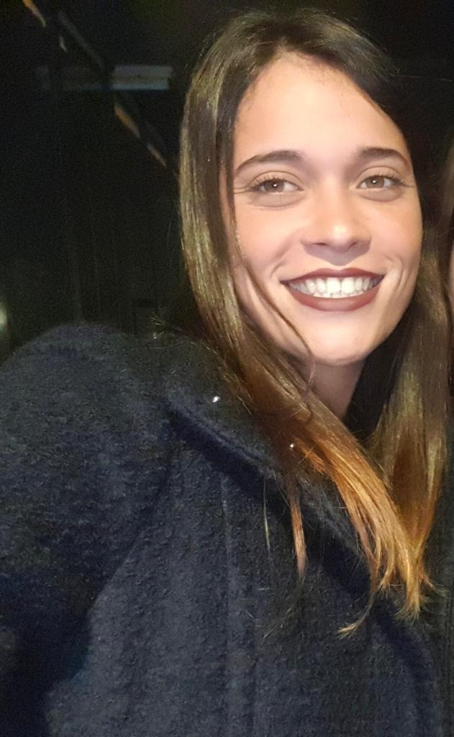
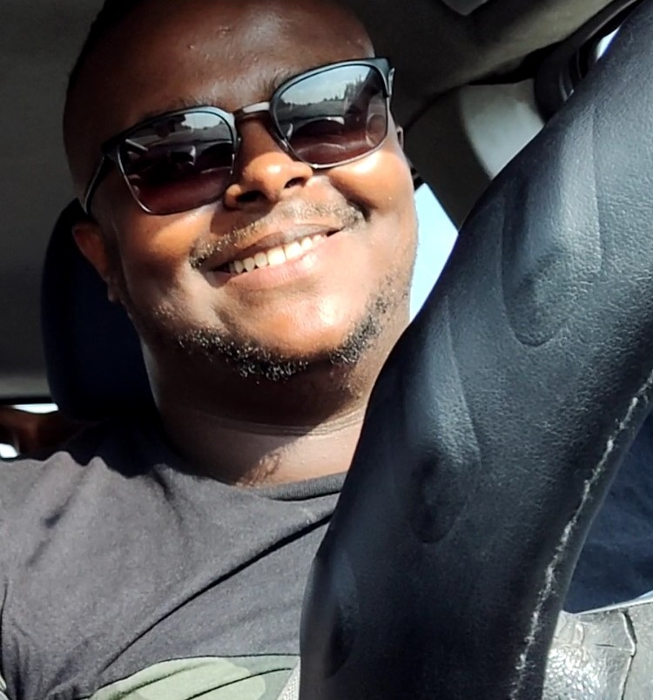
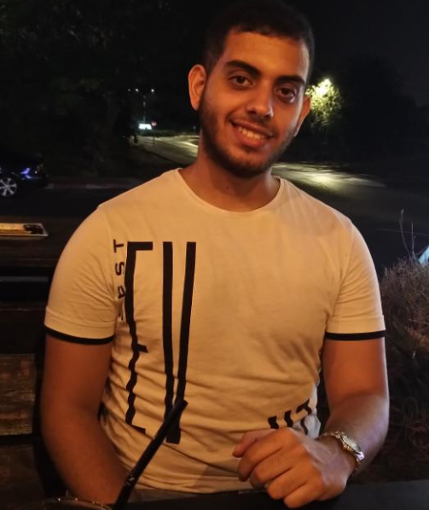
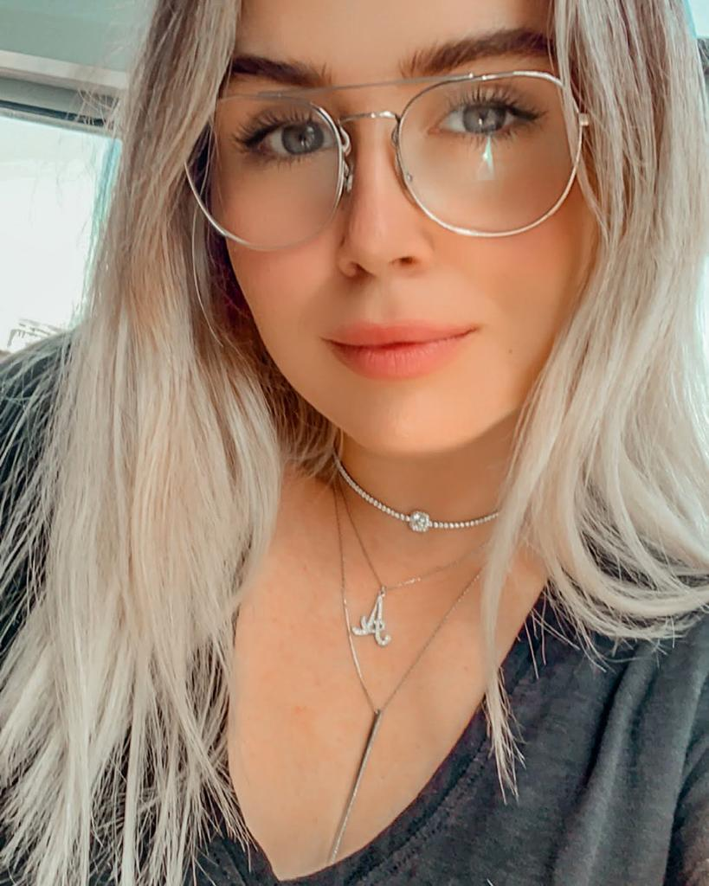
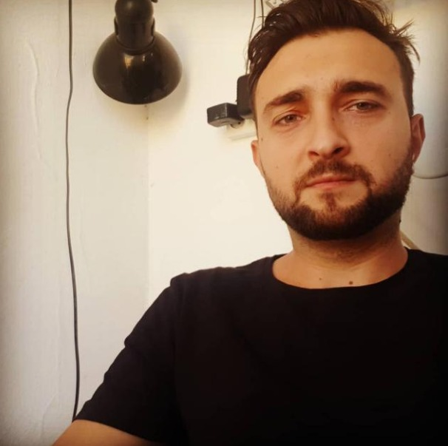
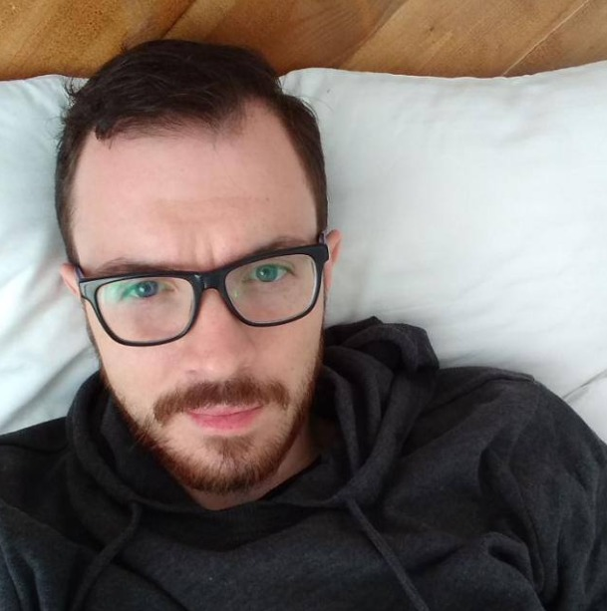
Team 2
Coral Avital
Adane Adgo
Tomer Handali
Second year software engineering student.
25 years old from Ashdod.
Second year software engineering student.
25 years old from Ashdod.
Second year software engineering student.
20 years old from Rehovot.
Alice Aidlin
Slava
Jirov
Vlad
Kelar
Second year software engineering student.
22 years old from Ashdod.
Second year software engineering student.
28 years old from Ashkelon.
Second year software engineering student.
26 years old from Ashdod.
LECTURER: Beni Sand
COURSE INSTRUCTOR: Harel Jerbi

Slide 4
Our system

Slide 5
Our features
Client demands
Additionas
Security
Client demands main features that client demented.
Additions Our extras for the client.
Security data information.

Slide 6

Client Demands
Comprehensive ability to modify the Packages data base.
Comprehensive ability to modify the Orders data base.
Comprehensive ability to modify the Users data base.
efficient Comminution ability between users.

Slide 7

Additions
Flex management ability by the manager.
Coupon system.
Visitor's accessibility.
Popular package by ratings.

Slide 8

Security
Highly encrypted data base.
Case sensitive password.
No payment data logging.

Slide 9

Main requirements
List of active agents in the company for invitational the system.
The manager details.
Secure pc with keyboard and updated windows.

Slide 10
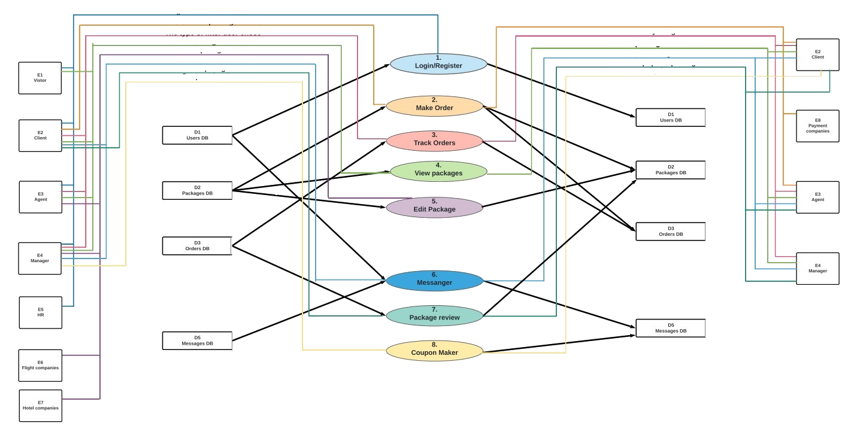
DFD
At this level, all the processes handled in the information system will be presented. In a very simple system, 3 bubbles can be created: input, processing and output.
Full documented file delivered

Slide 11
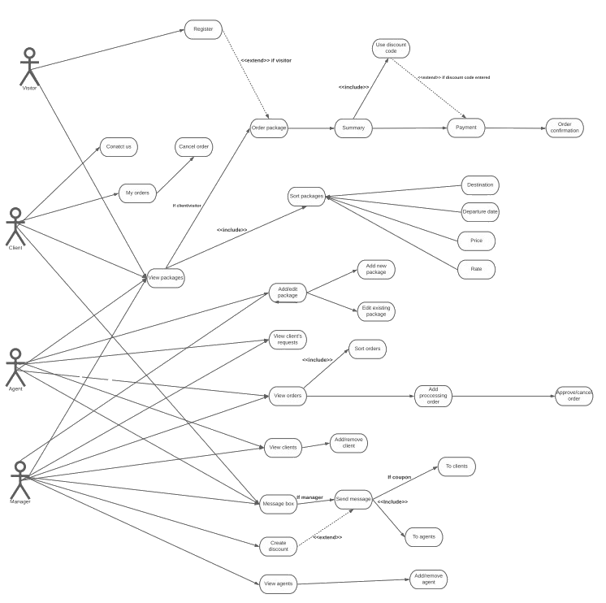
USE CASE
A usage scenario consists of one or more sequence of events, which describes how the system interacts with users to achieve a particular business goal or function.
Full documented file delivered

Slide 12

STP main tests
Tests
Login and register
Make an order
Track orders
View packages
Edit packages
Messenger
Package review
Coupon maker
Regressions test function
Full documented file delivered

Slide 13
Why Us?
Easy and convenient access to use
Each user has a customized menu that offers the features that are relevant to him. The connection process and / or the registration process are performed with one click and the steps are clear. Making an order can be easily done by the package number you want to order. Additional processes like package ranking or package search are simply made possible.
Information security at the highest level
The system uses a high-level encryption method so that the information cannot be used maliciously. All information is stored in encrypted text files that only the company can decrypt so that your information is always safe with us.
Please note that the customer's credit information is not stored in the system and customers can be calm in this regard.
Comprehensive and extensive testing that has brought us to a high level of performance
Every unit in the system, even the smallest, has been comprehensive, the results of which have guided us in repairing the system, in understanding the necessary steps on the way to improving the system.
In addition, regression tests were performed which included repairs that resulted in the wonderful system that we present to you today.

Slide 14
People tell us
תהייה לנו תחרות קשה איתכם ☺
הקוד נראה פצצה ☺
“
”
“
”
מתכנתים של מערכת מתחרה..
עבודה מעולה ☺
לקוח מרוצה..
“
”
הראל, מנחה הפרויקט..

Slide 15



Contact Information and references
1800-00-00
pack4u@gmail.com
https://github.com/SCE2020Team2/yesodot

Slide 16

Our challenges
Familiarity with the real world of software
For all team members this was the first time to step out of the code world and learn the process of building systems from scratch.
Time management
Not all testers always available for work meeting.
COVID-19
Ability to adapt to new changes and guidelines following the current situation
COVID-19
Ability to adapt to new changes and guidelines following the current situation

